Slide 1
Opioids – A Pharmaceutical Perspective on Prescription Drugs
Carol Ott, PharmD, BCPP
Clinical Professor of Pharmacy Practice
Clinical Pharmacy Specialist, Outpatient Psychiatry
Eskenazi Health, Indianapolis

Slide 2
Disclosures
The speaker has no conflicts of interest to disclose.
Consultant – Tippecanoe County Public Defender’s Office
Consultant – IU/Dept of Child Services Psychopharmacology Group
Member/Chair – Indiana Medicaid Drug Utilization Review Board
Member – Indiana Medicaid Mental Health Quality Advisory Committee
Member – Board of Directors – NAMI West Central Indiana

Slide 3
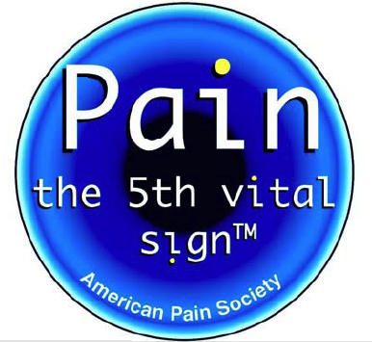
Pain as the 5th Vital Sign
First recognized in the 1990s
AMA 2016 – pain is not a vital sign, it is a symptom that cannot be measured like blood pressure
Heavy marketing by pharmaceutical manufacturers to use their products
AMA recommends removing pain as a vital sign
Concern by critics that pain would be ignored
Does “Pain as the 5th vital sign” increase
prescribing of opioids?

Slide 4
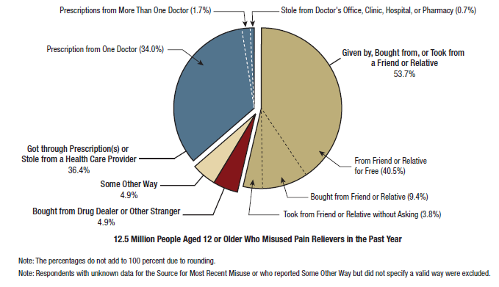
Where are Misused Prescription Opioids Coming From?

Slide 5
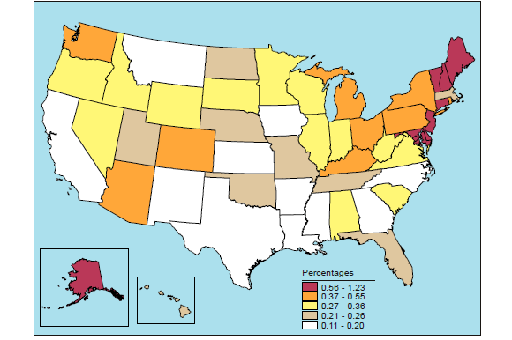
Prescription Opioids – Non-Medical Use

Slide 6
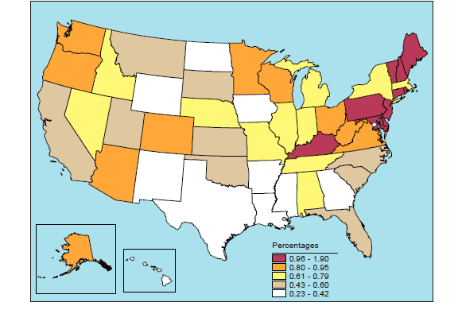
Heroin Use, Past Year, Adults 18 – 25, 2014-2015

Slide 7
CDC Guidelines to Limit Opioid Prescribing
Prefer to start with non-drug therapy and non-opioid medications
Have goals for pain and functioning
Use immediate-release opioids instead of extended-release for no more than 7 days for acute pain
Use lowest effective dose, lines out when increased monitoring is required
Review history of and risk factors for substance use
Use the prescription drug monitoring program for controlled substance prescriptions
Urine drug screening with chronic opioid therapy

Slide 8
Indiana Medicaid Opioid Regulations/Limits
Prior authorizations (PA) in place for opioid drug therapy
Prefer immediate-release products with 7-day treatment limit without PA
Long-acting products require PA
Follows CDC and Indiana Medical Licensing Board opioid prescribing rules
Covers methadone treatment in a narcotic treatment program (methadone clinic) as part of the medical billing
PA for Suboxone (buprenorphine/naloxone) has been suspended as of Dec 1, 2017 with monitoring of treatment program after prescribing
Vivitrol (naltrexone) long-acting injection requires PA for some insurers

Slide 9
Medication-Assisted Treatment for Opioid Use Disorder
Methadone – is an opioid – considered to be maintenance replacement therapy, must be administered under directly-observed daily clinic visits
Buprenorphine – is an opioid, but can become an opioid-blocker with higher doses, most often given in combination with naloxone to prevent injection use, prescribers must have a waiver to prescribe, does not require daily clinic visits, considered to be maintenance replacement therapy
Naltrexone – opioid-blocker – most often used in long-acting injection form given every 28 days, considered to be abstinence therapy

Slide 10
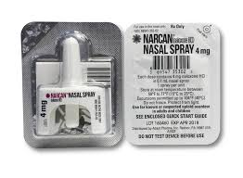
Naloxone
Aaron’s Law – July 2015 – removes civil liability from a pharmacist for dispensing naloxone at a community pharmacy
Pharmacies can dispense naloxone kits without a prescription under a standing order between a prescriber (state health commissioner) and a pharmacy/pharmacist
Two doses of naloxone per dispensing to allow for enough doses for EMTs to arrive
Indiana Medicaid covers naloxone kits in a limited number per year

Slide 11
Criminal Justice Issues
County jails do have medical providers, but don’t always have substance abuse evaluations or treatment
Inmates go through detoxification in jail since they don’t have access to drugs
May leave jail and go back to the same life without intervention with psychosocial services
Generally don’t have insurance or Medicaid, so there is no way to pay for treatment once the inmate leaves jail
Some jails are working on addictions treatment programs within the jail or community corrections

