Slide 1
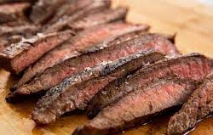
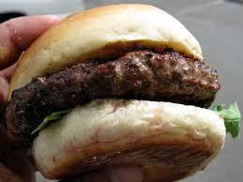
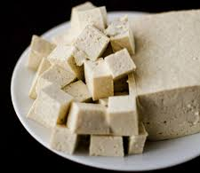
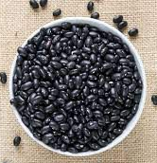
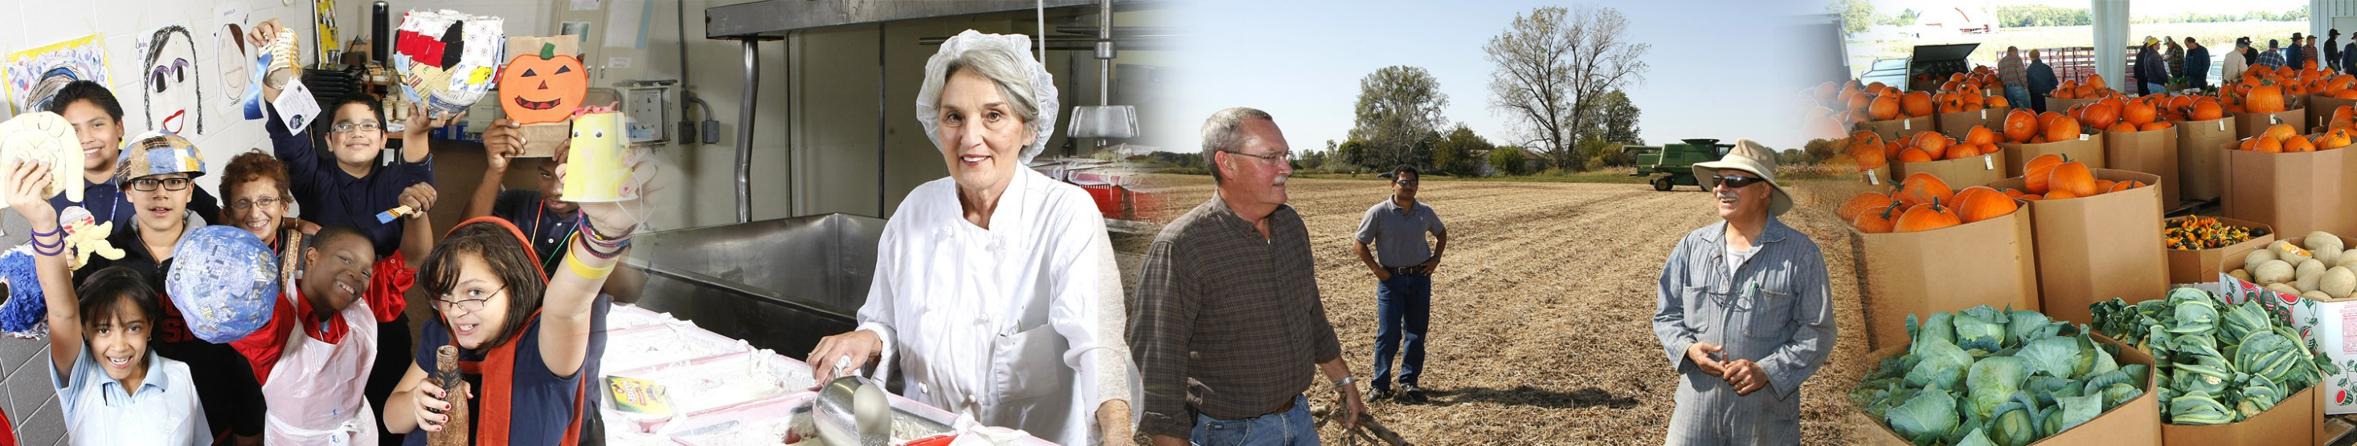
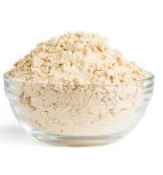
Plant and Animal-Based Proteins:
A Comparative Nutritional Assessment
Stacy M. Scramlin Zuelly, Ph.D.
Assistant Professor, Department of Animal Science
July 7, 2020

Slide 2

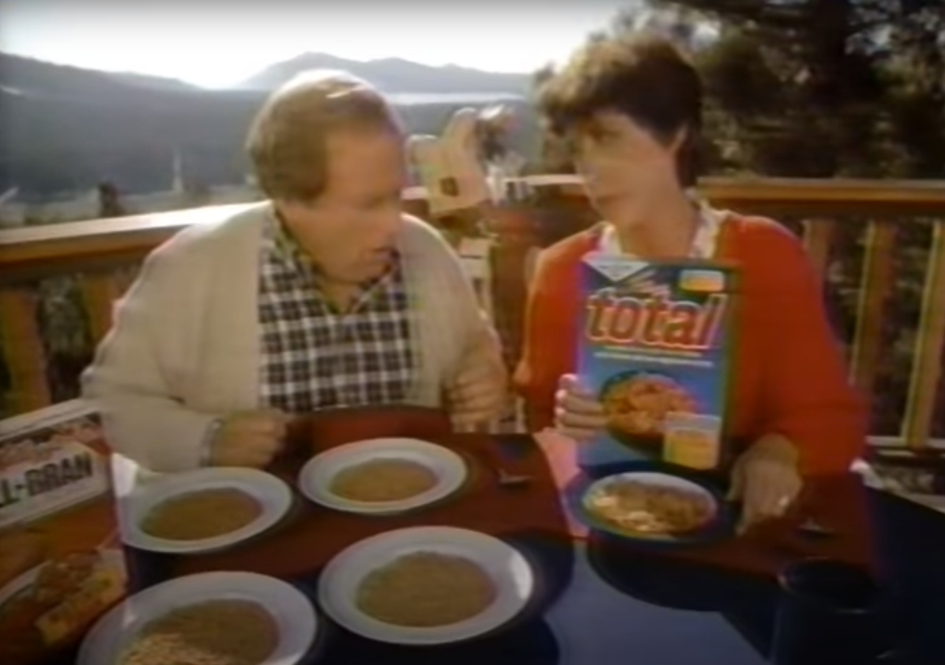
Why do we eat meat?
Are all food sources created equal?

Slide 3
Why eat meat?
Positives:
“Negatives”:
Protein (amino acids)
B Vitamins
Minerals
  Except Calcium
Fat content
Carbohydrates
Cholesterol
Notes:
Negative is a point of view; fat has become more widely debated as to whether or not it is “bad” in the diet.

Slide 4
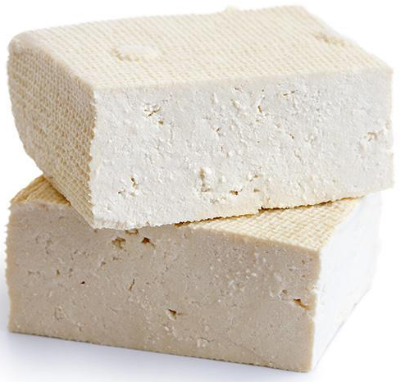
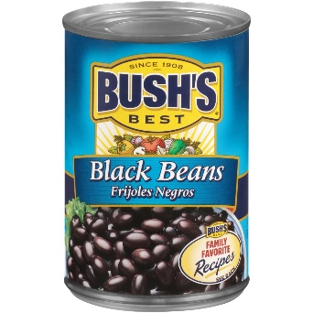
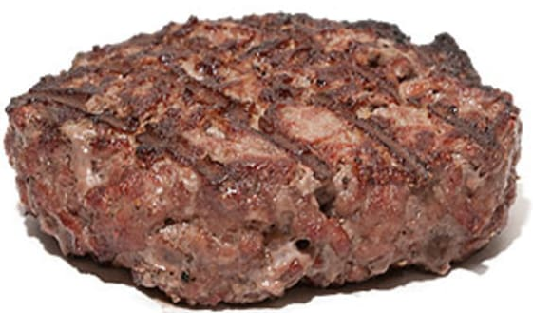
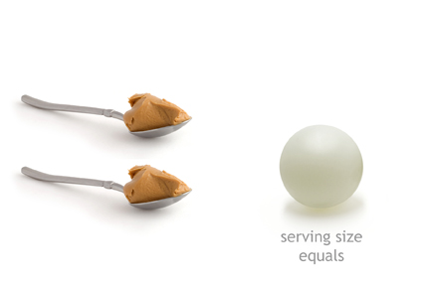
Protein – Concentration
Provide amino acids the body cannot produce
Requirements depends on age group
Animal-based proteins have a lower calorie to protein ratio
  Less calories per gram of protein
25 g Protein
4 oz lean beef patty
1.4 c firm tofu
1.9 c black beans
¾ c peanut butter
138
5.5
217
8.7
395
15.8
549
22
Notes:
Calories
Calories : g protein
6.4 Tbsp peanut butter
Review: Nutrient density and nutritional value of meat products and non-meat foods high in protein https://www.sciencedirect.com/science/article/pii/S0924224417300067?casa_token=6YEr89_qo8QAAAAA:7ONqOsWamggaUw2-EvrFK0iWr7tU6Vhsu7AnokKoKnGQCDOJXRLHf5m0YY4-BtczLu5eQA9s-w

Slide 5
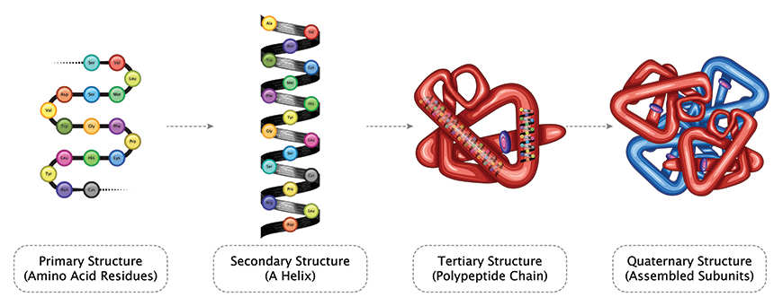
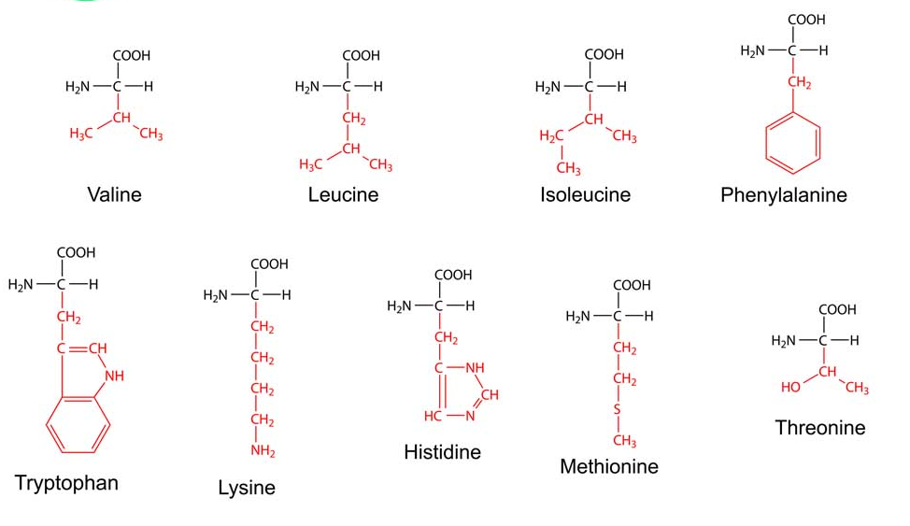
Protein – Composition
“Complete Protein”
  All 9 essential amino acids (EAA) in adequate concentrations
    Cannot be synthesized by the body
  Highly digestible
  Easily absorbable
Notes:
Animal proteins are 90-100% digestible

Slide 6
Essential Amino Acids
Amino Acid | US mg / kg body wt.
Histidine | 14
Isoleucine | 19
Leucine | 42
Lysine | 38
Methionine + Cysteine | 19 total
Phenylalanine + Tyrosine | 33 total
Threonine | 20
Tryptophan | 5
Valine | 24
Protein Sources | Limiting Amino Acid
Wheat | Lysine
Rice | Lysine
Legumes / Pulse | Tryptophan, Methionine (or Cysteine)
Corn | Lysine & Tryptophan
Meat, milk, eggs | None
Notes:
These are the US recommendations, which are higher than the WHO recommendations (by a small amount) except for Isoleucine and Valine, which are slightly lower than the WHO recommendations

Slide 7
Protein
Animal source proteins are all “complete proteins”
Plant-based proteins
  Lower EAA content
    Lower concentrations to meet all guidelines
  Less digestible

Slide 8
Meat in the Diet – B-Vitamins
Need:
  red blood cell formation, neurological function, and DNA synthesis
B12 is unique to animal-based products
  Contain the recommended amount for all ages
Plant-based foods do not contain B12
  May be fortified

Slide 9
Meat in the Diet – Minerals
Iron
  Need: Oxygen movement, Blood cell health, Brain function
  Heme iron
    More bioavailable
      15-40 %
    Not found in plant foods
  Non-heme iron
    Less bioavailable
      1-15%
    Only iron found in plant foods
      Need to consume 1.8x in order to match 1 meat serving

Slide 10
Meat in the Diet – Minerals
Iron, con’t
  Best method??
    The “meat” effect – Eat both plants & meat
      Eating meat actually helps pull non-heme iron (& zinc) from plant sources
    Pair with foods high in vitamin C
      Same as “meat” effect

Slide 11
Meat in the Diet – Minerals
Zinc
  Need: immune system, cell division, cell growth, wound healing, and the breakdown of carbohydrates
  Plant-based foods have anti-nutritional components lower bio-availability and/or absorption
    Can impact digestibility of minerals
    Well designed diet can meet needs of zinc without meat
Notes:
oxalates, tannins, polyphenols, and
B.M. Bohrer / Trends in Food Science&Technology 65 (2017) 103e112110Day, 2013Jones, 2016Neacsu, McBey,&Johnstone, 2017Hunt, 2003Hunt, 2003Hunt, 2003phytic acid

Slide 12
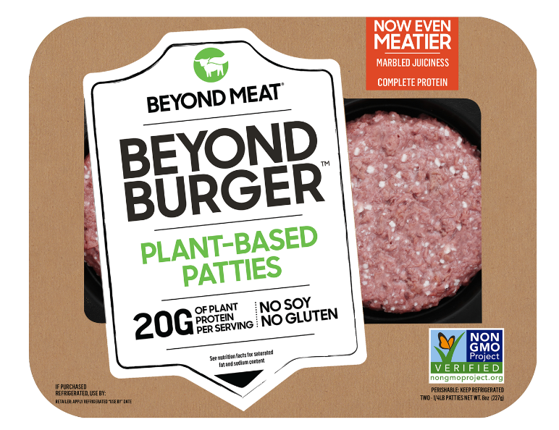
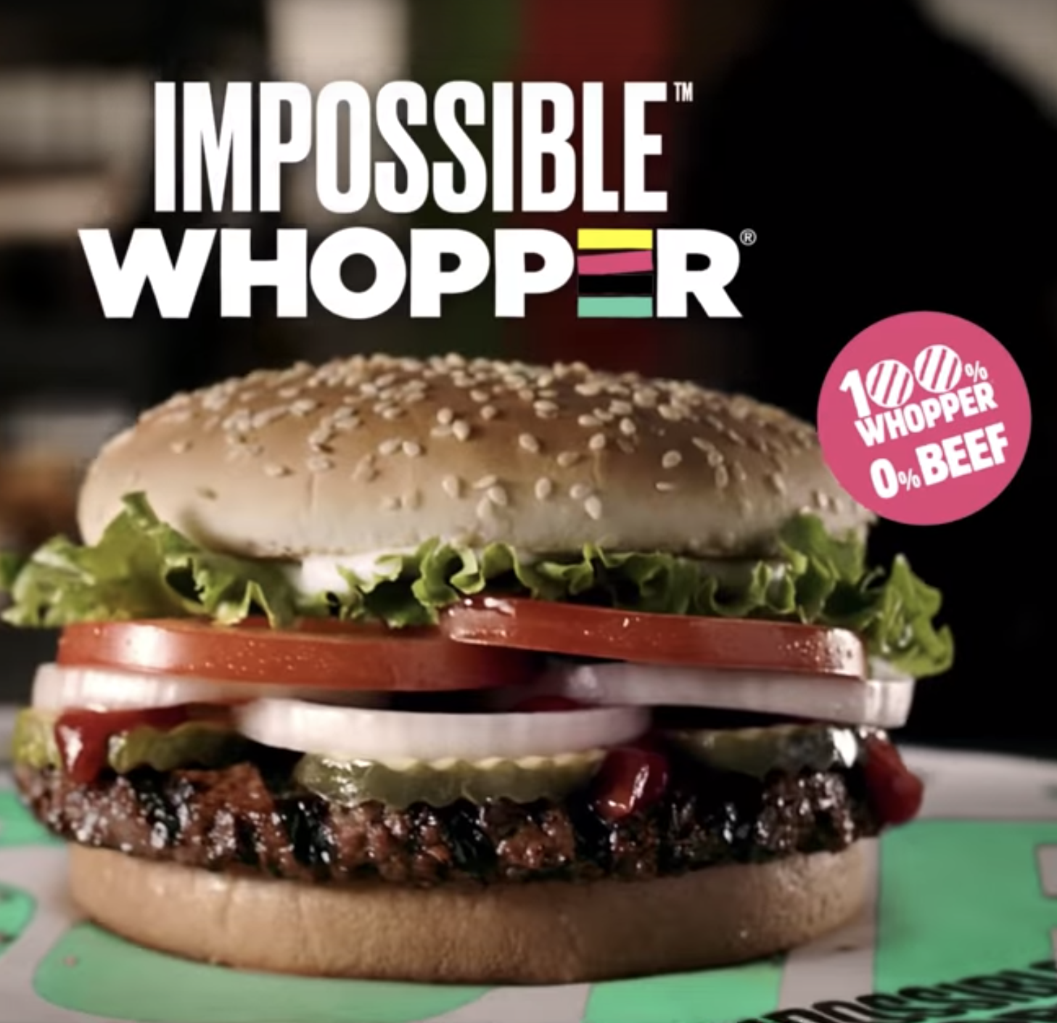
Burger Alternatives
Beyond Burger
  Protein: Pea, Mung Bean, Fava Bean, Brown Rice
  Fats: Cocoa Butter, Coconut Oil, Sunflower Oil, Canola Oil
  Minerals: Calcium, Iron, Salt, Potassium Chloride
  Flavors and Colors: Beet Juice Extract, Apple Extract, Natural Flavors
  Carbohydrates: Potato Starch, Methylcellulose (plant fiber derivative)
Impossible Burger
  Protein: soy
  Flavor: heme (yeast extract)
  Fats: coconut and sunflower oil
  Binders: methylcellulose, food starch

Slide 13
Let’s Compare Burgers
 | Beyond Burger | Impossible Burger | Ground Beef Patty
Calories | 260 | 240 | 307
Total Fat | 18 | 14 | 20.1
Saturated Fat | 5 | 8 | 7.7
Trans fat | 0 | 0 | 0.9
Cholesterol | 0 | 0 | 91.6
Sodium | 350 | 370 | 84.3
Total Carbohydrates | 5 | 9 | 0
Dietary Fiber | 2 | 3 | 0
Total Sugars | 0 | 0 | 0
Protein | 20 | 19 | 29.2
Calories : Protein | 13 | 12.6 | 10.5
Notes:
Ground beef values can vary quite a bit. This is an 90/10 burger

Slide 14
Non-Meat Diets
Very possible
Need variety to meet dietary needs
Not recommended for youth

Slide 15
Take Home Message
Protein
  Plant-based foods contain 20-60% the protein density of meat
    Are not considered “complete protein” sources
  Cost
    When expressed as grams of protein / US dollar were similar
Vitamin B12
  Not found in plant-based foods
Minerals
  Iron: plant-based foods do not contain heme iron
  Zinc: Possible to obtain through non-meat sources, but difficult
Notes:
Nutrient density and nutritional value of meat products and non-meat foods high in protein https://www.sciencedirect.com/science/article/pii/S0924224417300067?casa_token=6YEr89_qo8QAAAAA:7ONqOsWamggaUw2-EvrFK0iWr7tU6Vhsu7AnokKoKnGQCDOJXRLHf5m0YY4-BtczLu5eQA9s-w

Slide 16
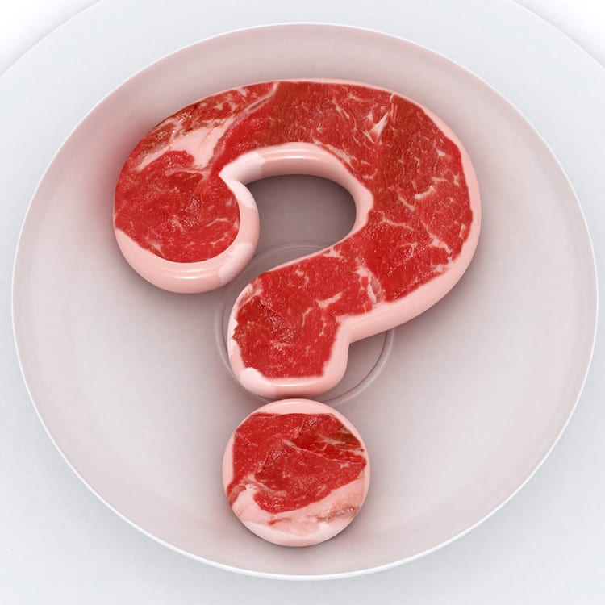
Thank You!

