Slide 1
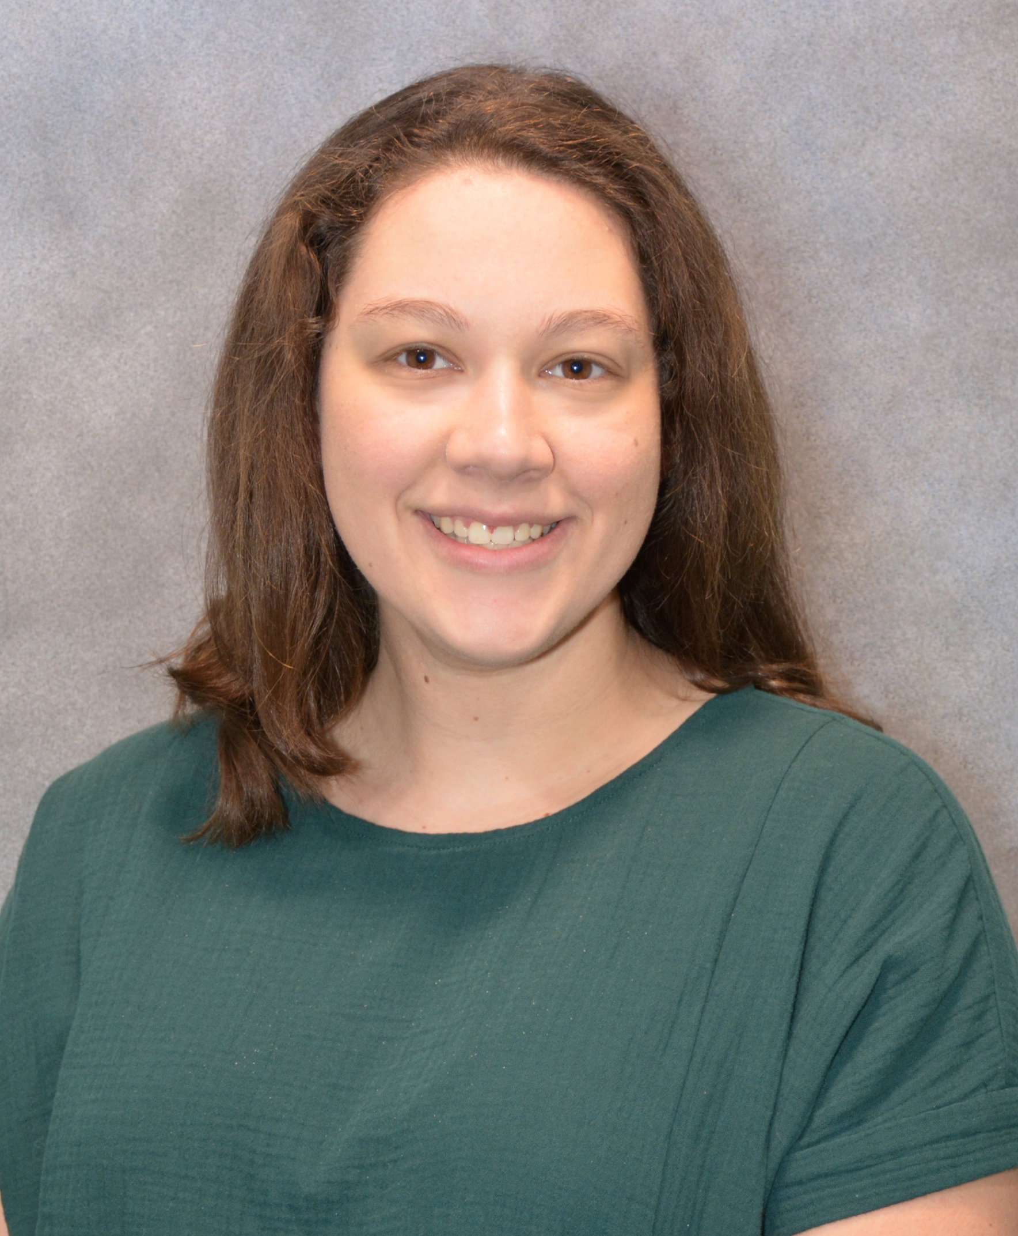
The Department of Animal Sciences
presents
Sara Scinto
Monday, July 8, 2024
2:00 p.m. CRTN 1042
Or Join Zoom Meeting
https://purdue-edu.zoom.us/j/92958435369
Meeting ID: 929 5843 5369
“A Functional Role of Delta Like 1 Intracellular Domain in Skeletal Muscle.”
Final Defense Seminar
Major Advisor: Dr. Shihuan Kuang
Partial Fulfillment of the Master of Science Degree

