Slide 1
Renewable Energy Practice in Indiana
Bill Hutzel, P.E.
Professor of Mechanical Engineering Technology
Purdue University
Presented to:
Farm Policy Study Group
July 7, 2020

Slide 2
Applied Energy Laboratory (AEL)
8 kW solar array
Thermodynamics
Building Automation
Indoor Air Quality (IAQ)
Net Zero Energy Buildings

Slide 3
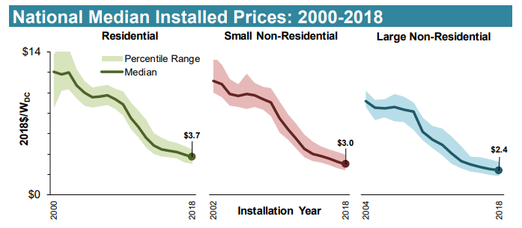
Energy Trends - Electricity
Energy use (Btu/ft²) in buildings is declining
Utility rates are increasing
Installed cost of solar is decreasing
Source: LBNL “Tracking the Sun”

Slide 4
Benefits of DER (Distributed Energy Resources)
Grid Independence / Security
Resilience
Environmental
Cost Savings?

Slide 5
Challenges of DER (Distributed Energy Resources)
Public Acceptance
Operation & Maintenance
First Cost / Risk
Grid Interactions
Municipality Interactions
Permitting, Inspections, Emergency Response

Slide 6
Economics of Solar
First Cost – on the order of $2.50 / Watt
Incentives
Federal – 30% tax credit being phased out
State – property tax exemption
Utility - varies
Financial impact for Indiana
10 to 15 year payback
7 to 10% ROI

Slide 7
Indiana Net Metering
Net metering is the agreement that requires utilities to buy DER
Many states tie net metering rates to the retail cost of electricity
Indiana ties net metering rates to the cost of generation
DER OWNERS SHOULD USE ALL OF THE ELECTRICITY THEY GENERATE

Slide 8
Case Study James Cole Elementary
2nd Place Finish in 2020 Competition

Slide 9
Motivations for Net Zero Energy
INTRODUCTION
Energy efficiency upgrades help finance the solar energy
Mindfulness
Model for school renovations
Disaster recovery center
Reasonable financial ROI
TSC’s electric rates increase by 16% next year!
Increasing sustainability education
Notes:
5 mins

Slide 10
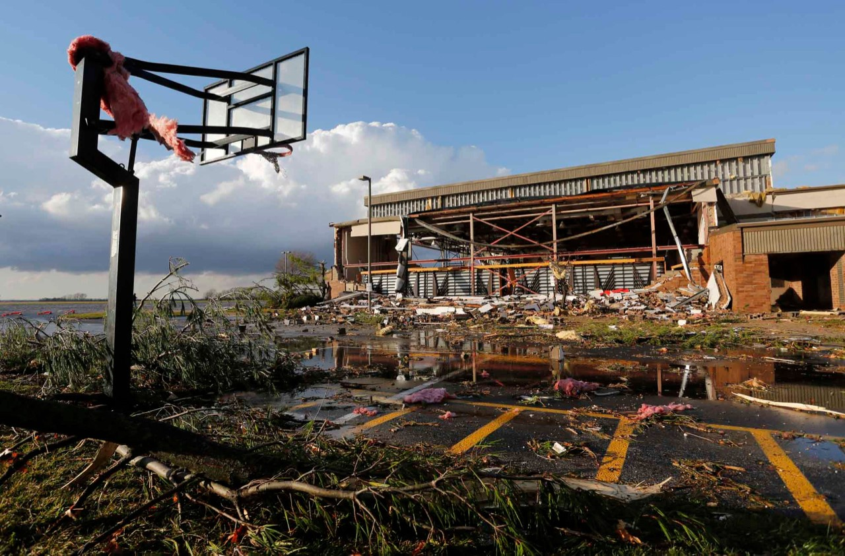
Resilience
ARCHITECTURE
IEQ
ENGINEERING
OPERATIONS
ENERGY
INNOVATION
FINANCIAL FEASIBILITY
MARKET POTENTIAL
Event | Likelihood
Power Loss | Medium
Severe Storm / Tornado | Medium
Fire | Low
Flood | Low
Global Flu Pandemic | Very Low
2013 Tornado at TSC’s Southwestern Middle School

Slide 11
Solar Options for Schools
Owner-operated
ESCO provides design, installation, and maintenance contract for energy efficiency and solar upgrades
Solar installation financed by a school bond
Achieves highest ROI for school
School assumes risk for solar array
3rd Party ownership
Outside party provides design, installation, and operation
School gets a discount on its energy bill
School assumes essentially none of the risk
Duke Energy Indiana has a pilot program for this type of work

Slide 12
Coordinating with the Area Planning Commission
Local resistance to wind farms
New ordinance essentially prohibits wind turbine installations in Tippecanoe County due to expectations for growth
Discussions underway about implications for solar

Slide 13
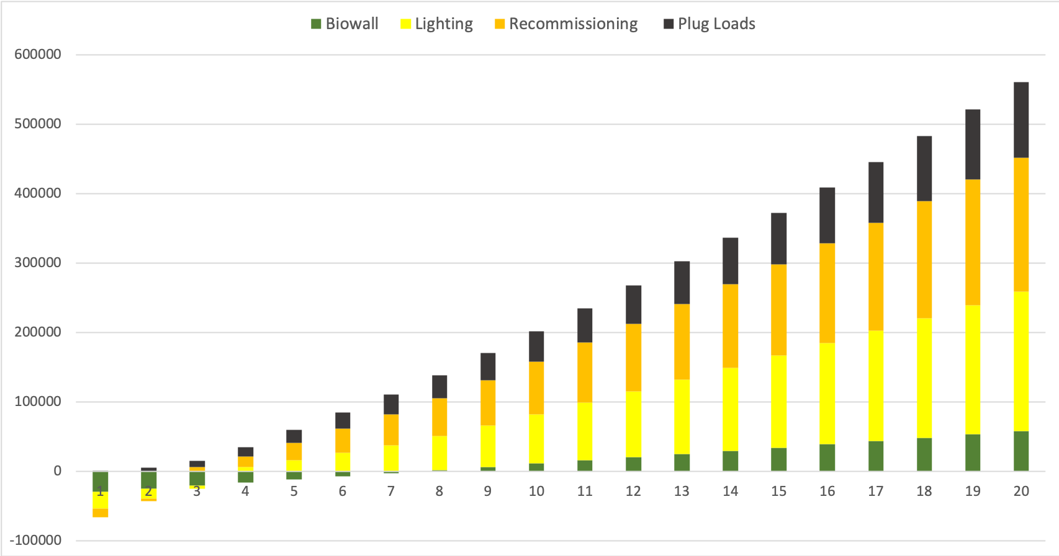
Energy Efficiency Payback
ARCHITECTURE
IEQ
ENGINEERING
OPERATIONS
ENERGY
INNOVATION
RESILIENCE
MARET POTENTIAL

Slide 14
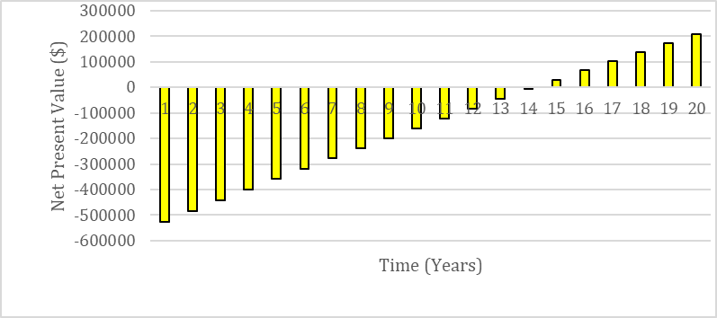
Solar Energy Payback
ARCHITECTURE
IEQ
ENGINEERING
OPERATIONS
ENERGY
INNOVATION
RESILIENCE
MARET POTENTIAL

Slide 15
Further Information
Applied Energy Laboratory
https://polytechnic.purdue.edu/facilities/applied-energy-laboratory
Bill Hutzel
765-494-7528
hutzelw@purdue.edu

