Slide 1
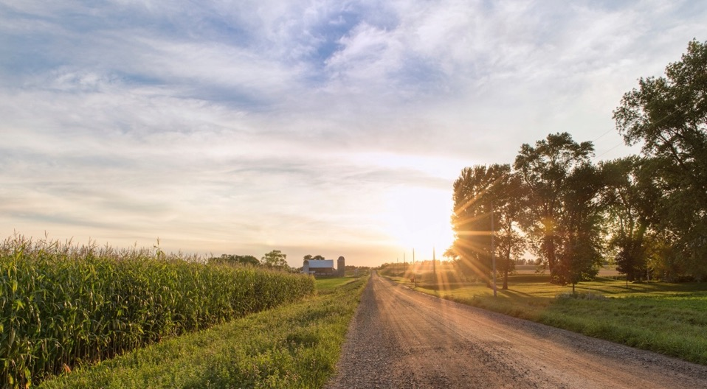


Indiana’s Agriculture in a Changing Climate
A report from the
Indiana Climate Change Impacts Assessment
Dr. Laura Bowling, Dept. of Agronomy
Dr. Jeff Volenec, Dept. of Agronomy
Dr. Janna Beckerman, Dept. of Botany and Plant Pathology
July 19, 2019
Farm Policy Study Group
#INCCIA
@PurdueCCRC

Slide 2
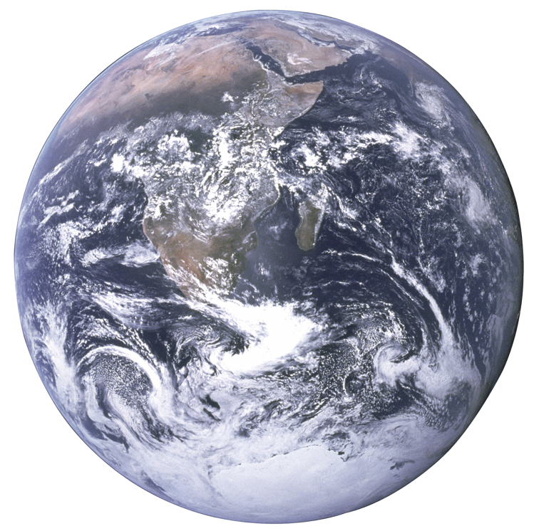
Hotter
Observed Global Temperature
+ 2ºF
1951 – 1980
AVERAGE
Environment is already responding
Warming trend projected to continue and intensify
Need to put global change into local perspective
- 2ºF
1880 2017
Colder
Source: NASA
Notes:
Information about annual means at global and regional scales is not sufficient for producers to understand the complexity of the changes they are facicng.

Slide 3
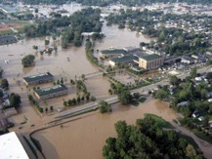
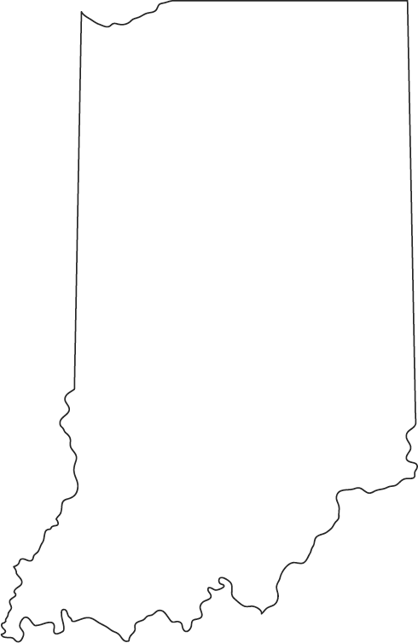
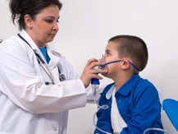
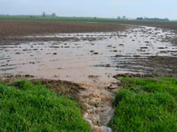
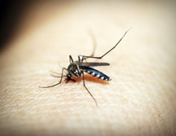
What will climate change mean in
INDIANA?
#INCCIA

Slide 4
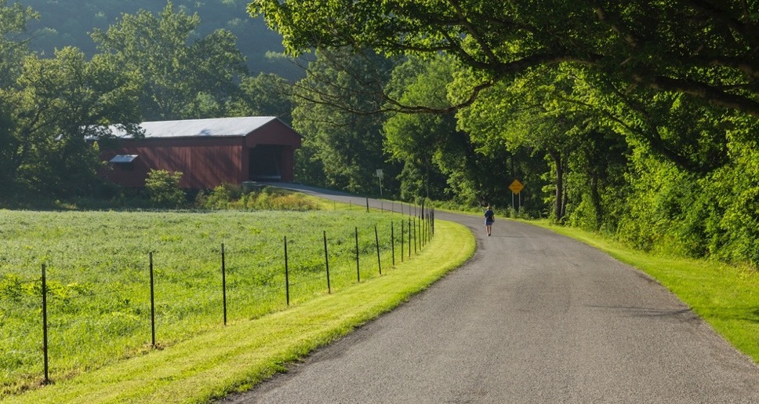


Technical contributions from:
Purdue University Northwest
Midwest Regional Climate Center
U.S. Forest Service
Northern Institute of Applied Climate Science
Indiana Department of Natural Resources
Marion County Public Health Department
Mesh Coalition
U.S. Geological Survey
Purdue Climate Change Research Center
University of Notre Dame
IUPUI
Indiana University
Indiana University Northwest
Ball State University
Indiana State University
#INCCIA

Slide 5
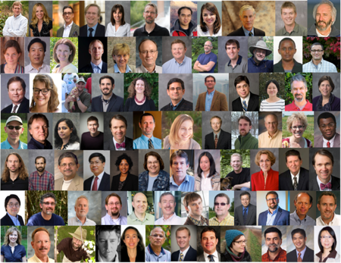

PURDUE CLIMATE CHANGE RESEARCH CENTER
Exploring the causes and impacts of climate change, improving predictive models to project future climate conditions, and pursuing novel ideas for mitigation and adaptation.
ESTABLISHED IN 2004
Broad-based support from academic and administrative units at Purdue
INTERDISCIPLINARY
80+ faculty representing 22 departments
NON-PARTISAN
Objective, science-based information
COLLABORATIVE
Partnerships with schools, NGOs, businesses, government agencies, farmers

Slide 6
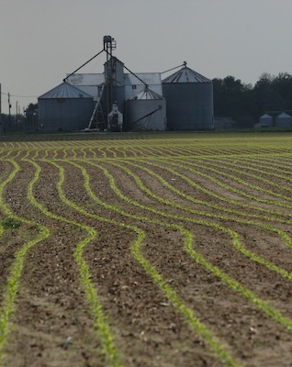

Impacts Assessment
BY THE NUMBERS
100 experts
50+ organizations
10+ reports
Scientists & decision makers participated in developing a series of reports that show how a changing climate will affect state and local interests.
www.IndianaClimate.org
#INCCIA

Slide 7
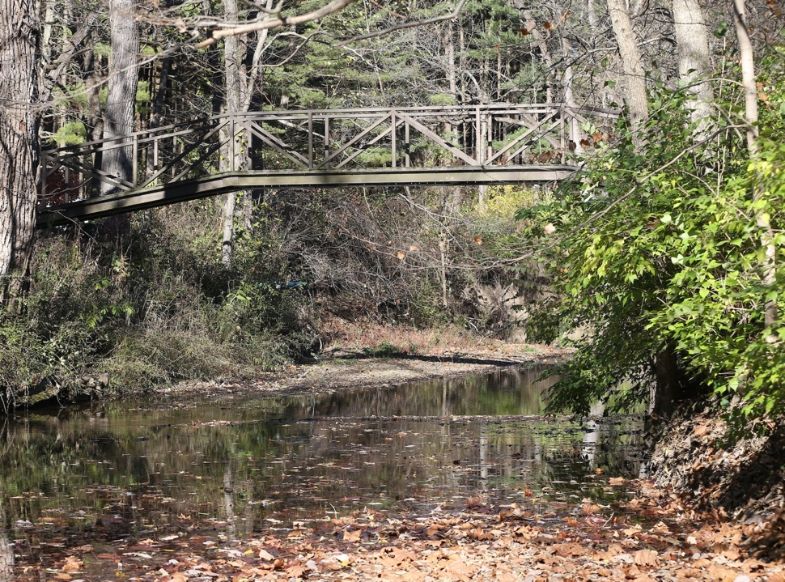

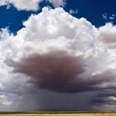



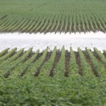
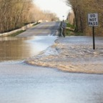
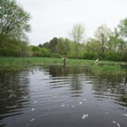
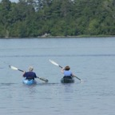
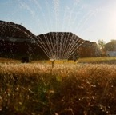
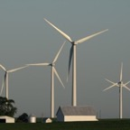
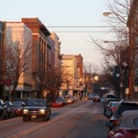
#INCCIA
IN CCIA Reports
Putting global change into local perspective
Climate
Health
Forest Ecosystems
Urban Green
Infrastructure
Agriculture
Assessment
Summary
Aquatic Ecosystems
Tourism & Recreation
Water Resources
Energy
Infrastructure
www.IndianaClimate.org

Slide 8
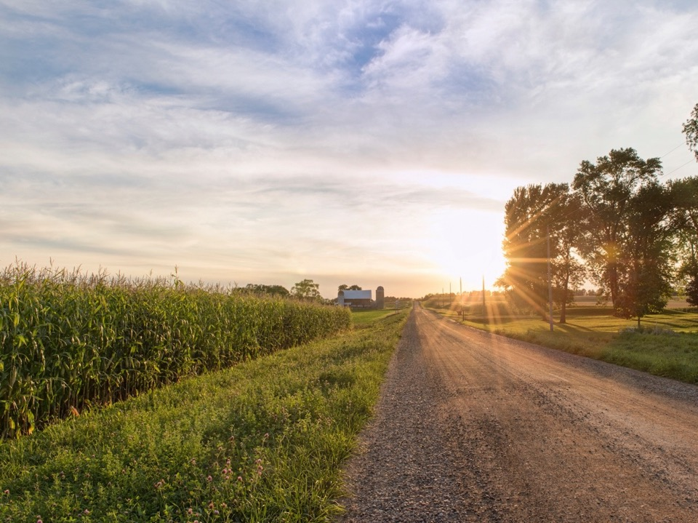

Agriculture Working Group
Laura Bowling (lead), soil hydrology
Janna Beckerman, plant disease
Sylvie Brouder, nutrient management
Jonathan Buzan, heat stress
Keith Cherkauer, water resources
Otto Doering, agricultural economics
Jeffrey Dukes, invasive species
Paul Ebner, animal science
Jane Frankenberger, water management
Benjamin Gramig*, agricultural economics
Eileen Kladivko, soil management
Charlotte Lee, water resources
Jeffrey Volenec, crop physiology/ecology
Cliff Weil, crop genetics
* Currently at University of Illinois

Slide 9
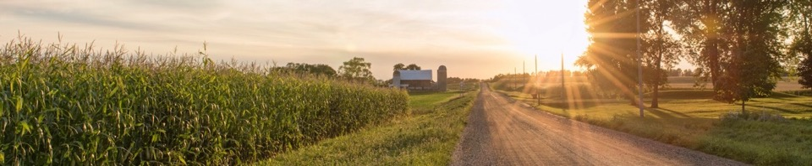
Indiana’s agricultural sector is productive
Indiana rankings:
  1st in ducks
  2nd in eggs
  3rd in soybeans,
  4th in turkeys
  5th in corn
  5th in hogs
  Top 10 for blueberries, peppermint, processing tomatoes, watermelon, cantaloupe, snap beans and cucumbers
107,000 jobs for Hoosiers
$31.2 billion in sales of ag-related products
$4.6 billion in annual exports
#INCCIA
Notes:
Hog data is from the 2018 census, 2nd in processing tomatoes in 2015 (out of 4 states reporting), 4th in mint in 2017, Indiana not in top 10 for domestic blueberries in 2017

Slide 10
How does weather affect agriculture?
Length of growing season
Date of first freeze
Heat extremes
Variable winter temperatures
Spring freeze/thaw cycles
Spring wetness
Heavy precipitation events
Water availability during the growing season
#INCCIA

Slide 11
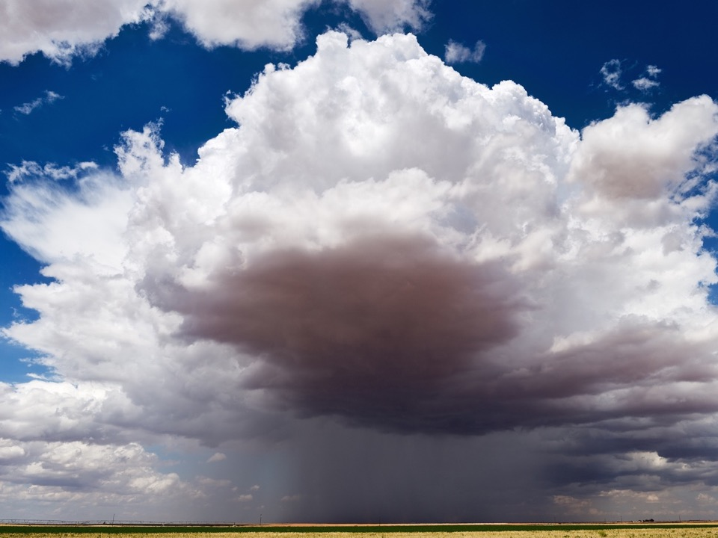


Indiana is getting warmer
Annual temperature has increased 1.2°F over the last century.
Warming expected to continue and intensify.
Indiana scientists used 10 climate models to look at future warming.
Range of outcomes based on medium- and high-emissions scenarios
Notes:
Warming in all seasons
Even more drastic warming by late century

Slide 12
Indiana is getting warmer
5°F to 6°F of warming expected by mid-century.
More extreme heat
Less extreme cold
Longer growing season
Notes:
Warming in all seasons
Even more drastic warming by late century

Slide 13
Indiana is getting wetter
Annual precipitation has increased 5.6” over the last century.
6% to 8% increase in annual rainfall is projected by mid-century.
Notes:
Also expect more rain coming in heavy downpours

Slide 14
Some seasons are getting
wetter
WINTER: 16 to 20% increase
SPRING: 13 to 16% increase
More falling as rain, not snow
Increased early-season soil saturation
Notes:
Also expect more rain coming in heavy downpours

Slide 15
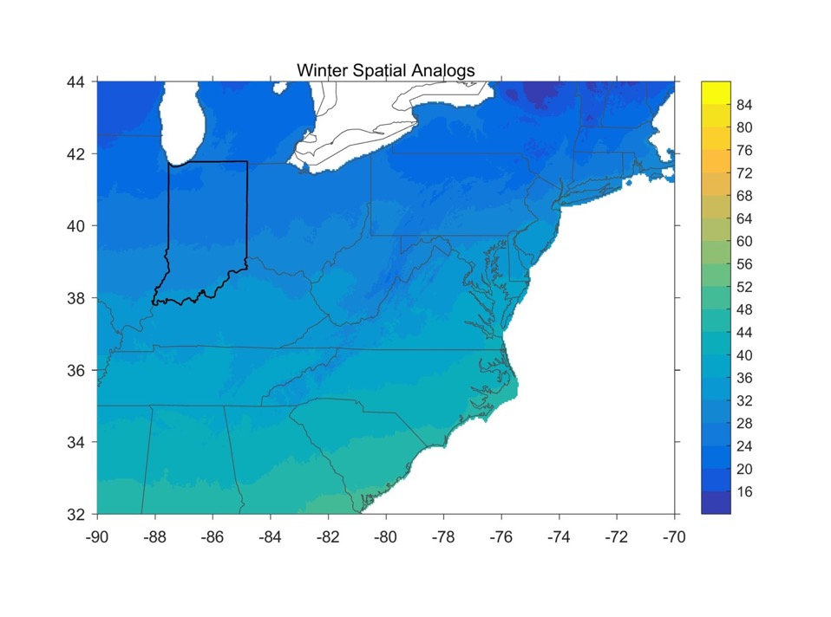

Slide 16
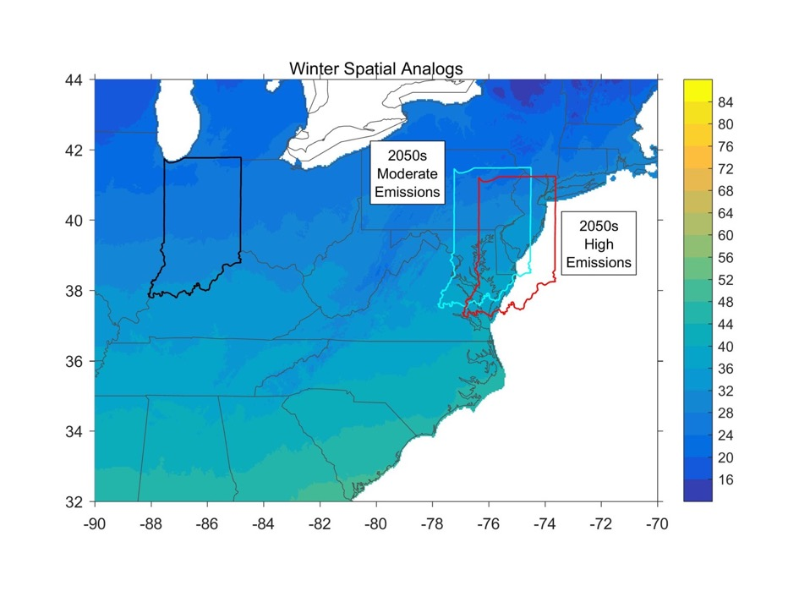

Slide 17
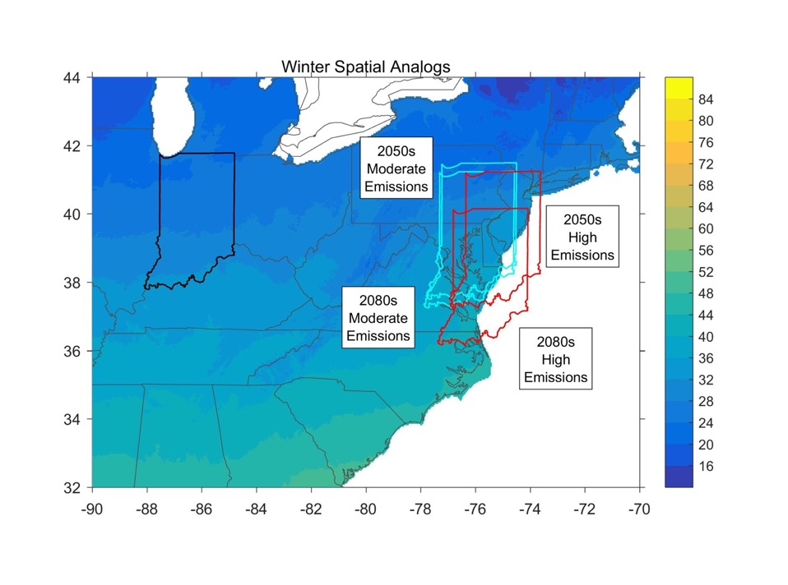

Slide 18
Some seasons are
getting drier
Summer & fall show slight declines, with less certainty in the projections
Increased water demand from added heat
Reduced plant available water
Notes:
Also expect more rain coming in heavy downpours

Slide 19
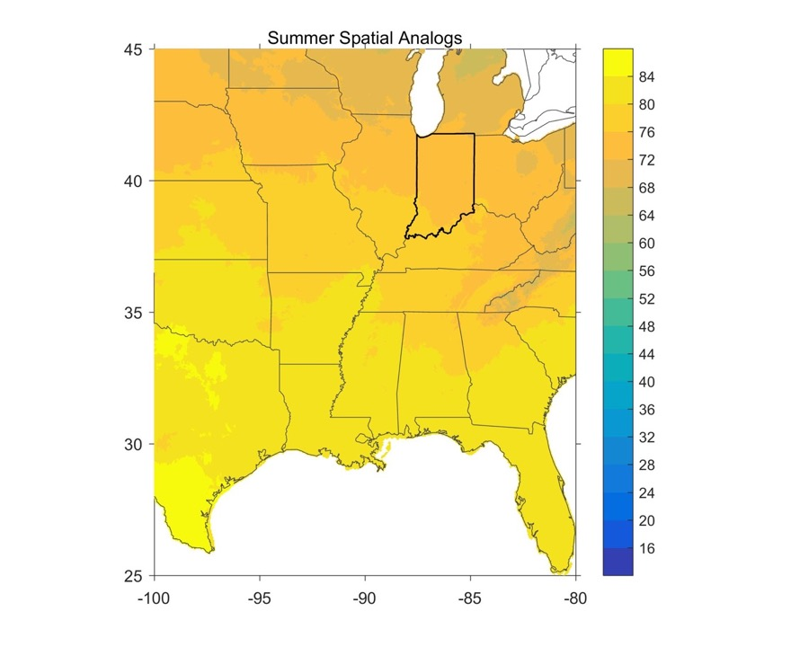

Slide 20
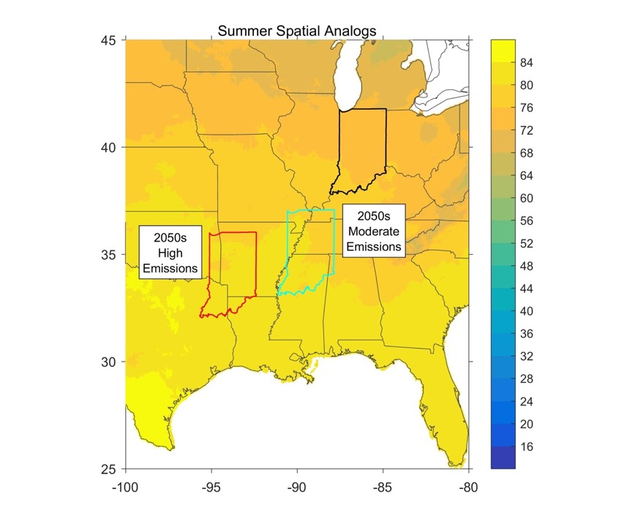

Slide 21
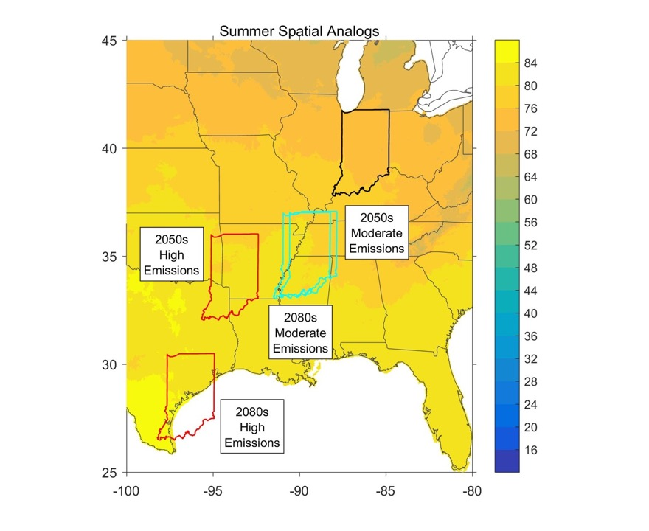

Slide 22

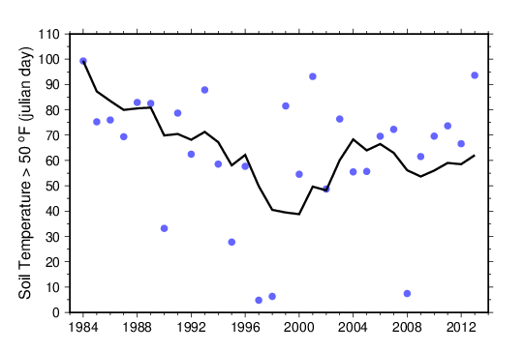
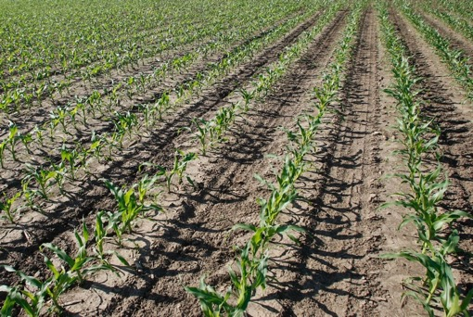
Growing seasons will be longer….
Average date when soil temperature first reaches 50ºF
#INCCIA
Results for West Central Indiana

Slide 23

Growing seasons will be longer….
Average date when soil temperature first reaches 50ºF
Feb. 6-12
Mar. 4
Future
Historical
21 - 27 days earlier
#INCCIA
Results for West Central Indiana

Slide 24
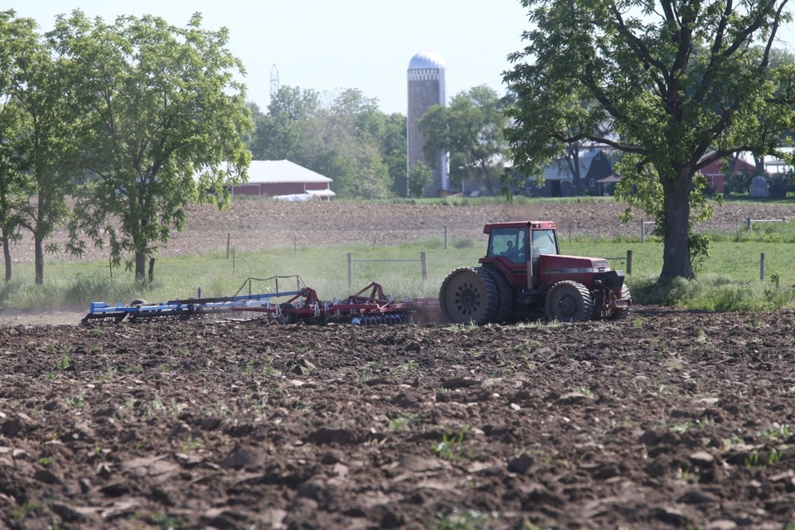
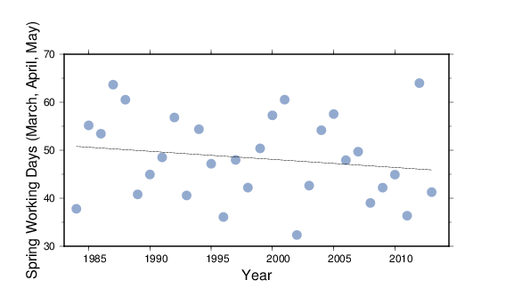
...but planting may not be much earlier
#INCCIA
Notes:
The number of days suitable for field work in April, May and June (as estimated based on simulated surface soil moisture, a relationship that has been validated with crop progress reporting data) is projected to decrease on average, but also to get more variable. So in dry years, planting can happen much earlier, but in over 50% of the time, it will be much later.

Slide 25
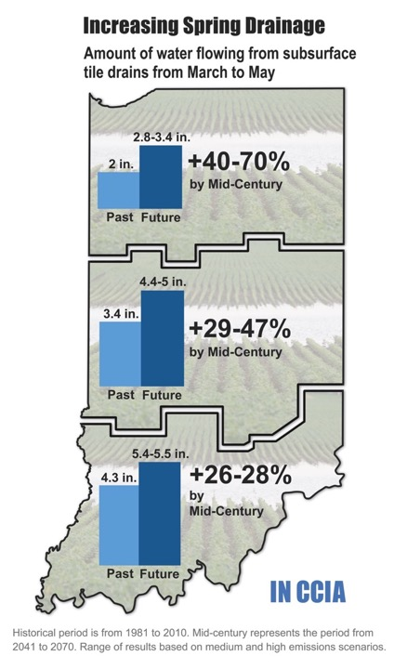
More spring wetness means more need for drainage
#INCCIA
Notes:
Conservation practices that capture drainflow during the non-growing season may mitigate increased nitrate loss.
Although irrigation may offset yield losses in corn and soybean, in most locations in Indiana irrigation will not be profitable, at current (2018) prices

Slide 26
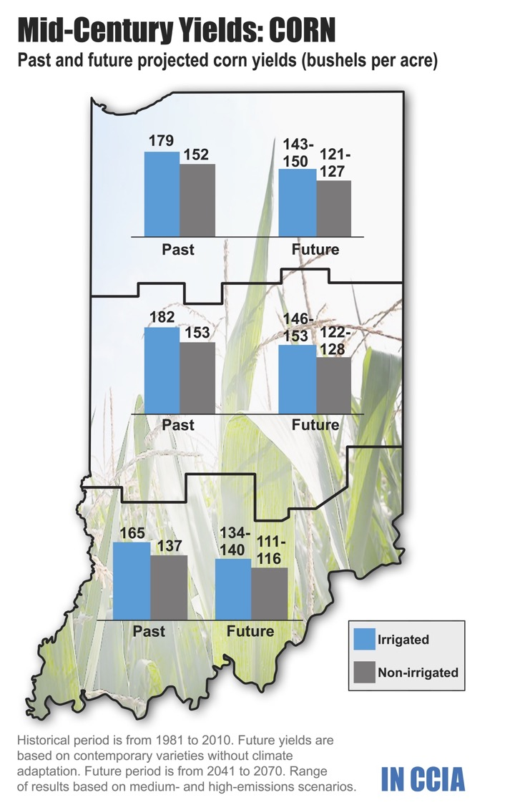
But row crops will still be hot and thirsty

Slide 27
Irrigation may have increasing benefit

Slide 28
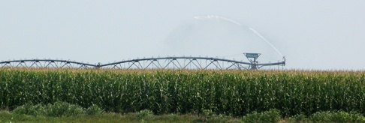
But irrigation will still not pay for itself
Irrigation can offset yield losses;
At current prices, increased income is not greater than the cost of investment in irrigation systems;
The Net Present Value of the difference between investing in irrigation and farming without irrigation remains negative; and
NPV continues to decrease in the future.

Slide 29
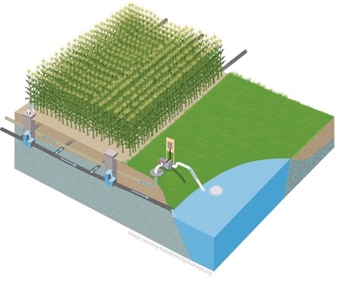
Increased potential for drainage water storage and reuse?
#INCCIA
Notes:
Conservation practices that capture drainflow during the non-growing season may mitigate increased nitrate loss.
Although irrigation may offset yield losses in corn and soybean, in most locations in Indiana irrigation will not be profitable, at current (2018) prices

Slide 30
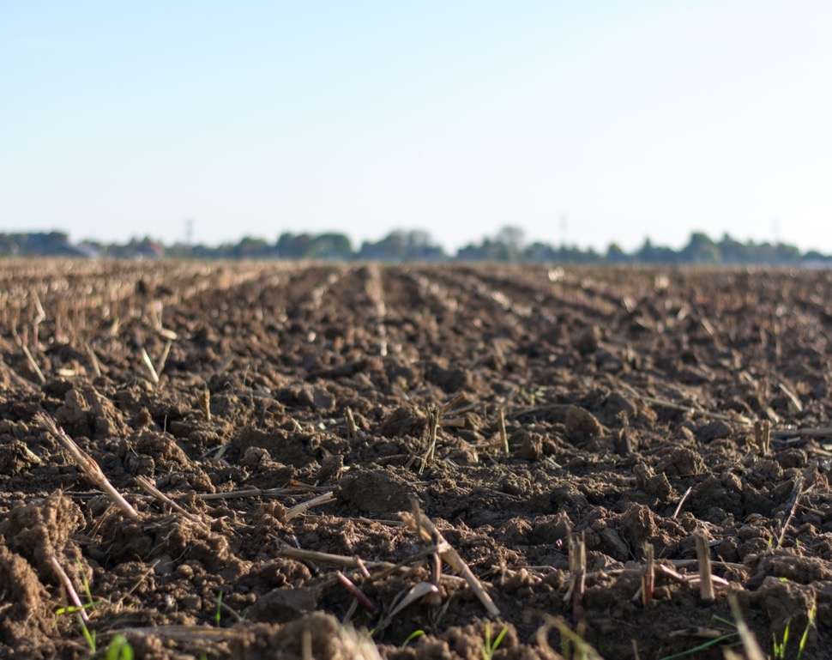
It will be harder to build soil organic matter
Increased spring rainfall → erosion
Warmer soils → increased decomposition
Reduced crop yield → decreased biomass input
#INCCIA
Notes:
VERBALLY DESCRIBE: Adopting management practices that improve overall soil quality, such as increased plant diversity, cover crops and reduced/no-till systems, can build soil organic matter even as temperatures warm.

Slide 31
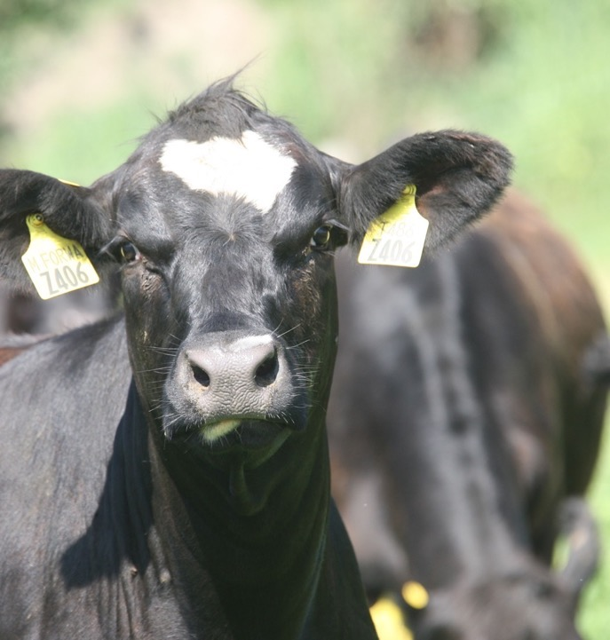
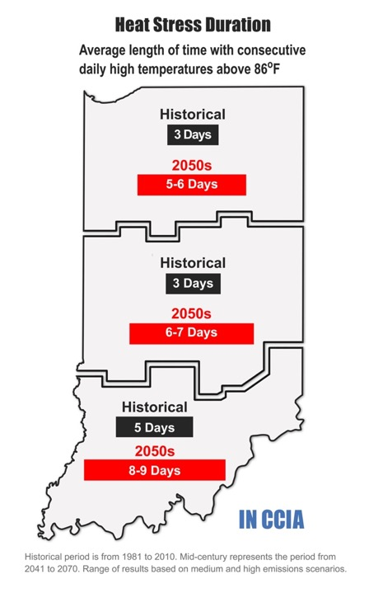
Indiana livestock will be hot
#INCCIA
Notes:
Higher temperatures will put Indiana livestock at increased risk of heat stress, which can lead to reduced animal feed intake, productivity and fertility.

Slide 32
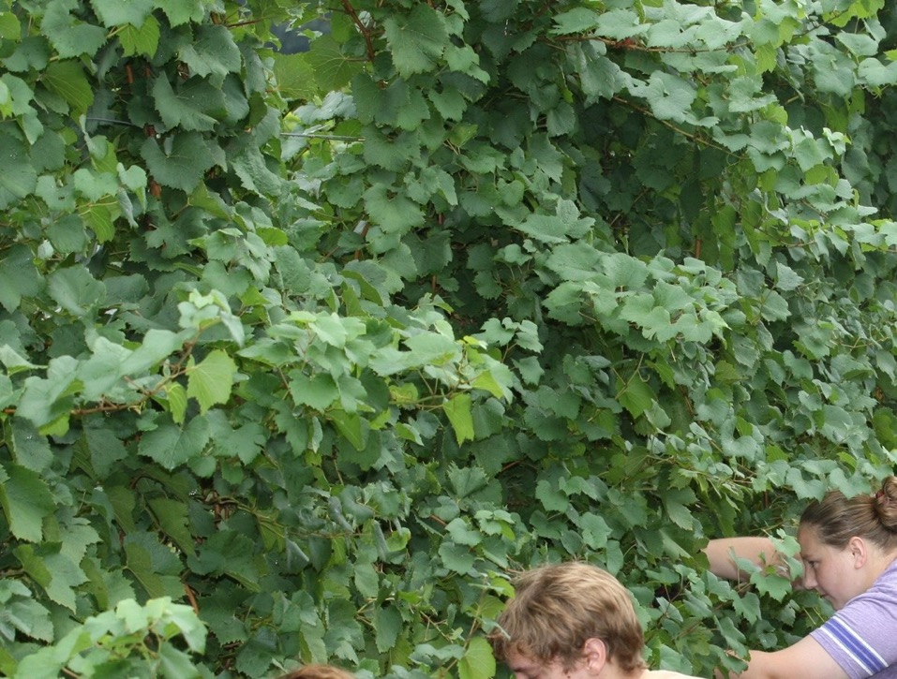
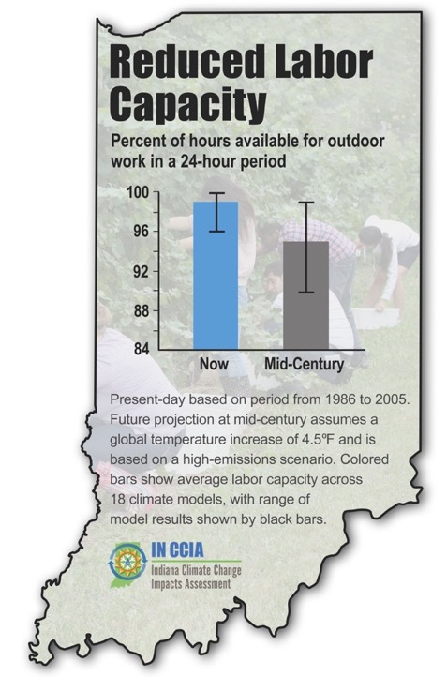
Farm labor will be affected too
Notes:
Replace with new illustration

Slide 33
Coping with growing season changes
Improving soil health & fall-planted cereal crops may help w/ managing additional spring rainfall
Breeding for flood tolerant and disease resistant varieties
Improving drainage infrastructure may be help accommodate higher flows
#INCCIA
Notes:
Need apple background

Slide 34
Coping with livestock heat stress
Improved or expanded ventilation systems for added temperature control
  Comes w/ increased energy, operating and maintenance costs
Additional shelters or other environmental buffers for pasture-based systems
  Added costs
#INCCIA
Notes:
Higher temperatures will put Indiana livestock at increased risk of heat stress, which can lead to reduced animal feed intake, productivity and fertility.
Need different livestock photo

Slide 35
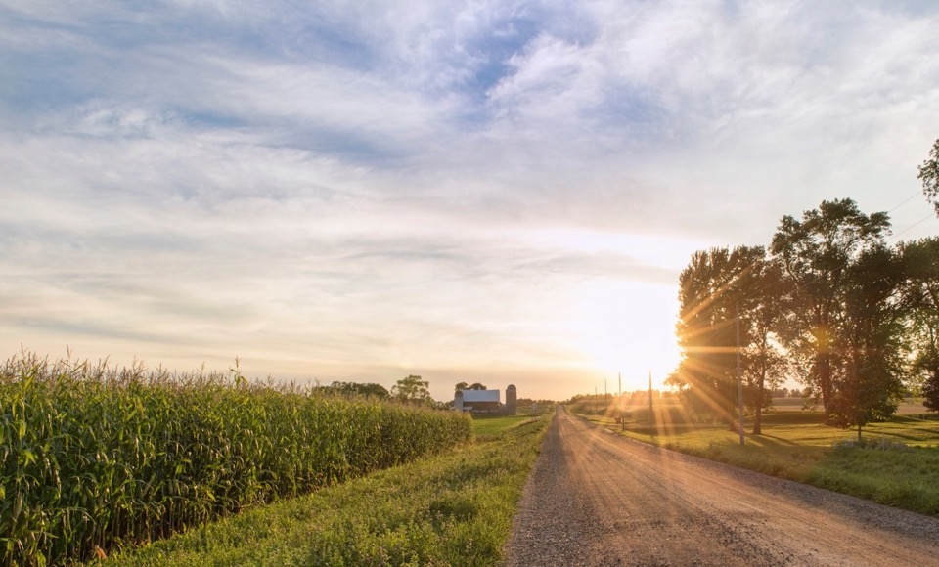


Summary of Key Conclusions
Increased heat (day and night) and water stress will reduce crop yields
Warming winters put perennial crops at risk
Heat stress and reduced forage quality will challenge livestock production
Pests, disease and weeds will be a growing problem for Indiana agriculture
Soil health and water quality are at risk
There is potential for significant impacts, but also many opportunities to cope with changes and keep Indiana agriculture productive.
www.IndianaClimate.org
#INCCIA

